Slide 1
Machine Learning: Algorithms and Applications
Graphical Models
Lab 10

Slide 2
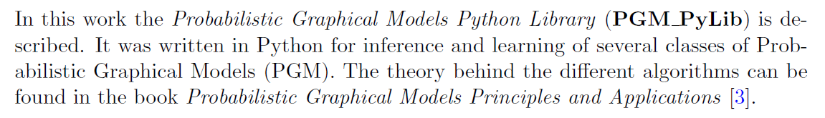
Graphical Models
Introduction

Slide 3
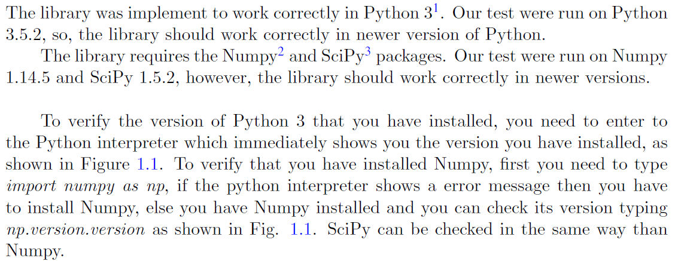
Graphical Models
Requirements

Slide 4
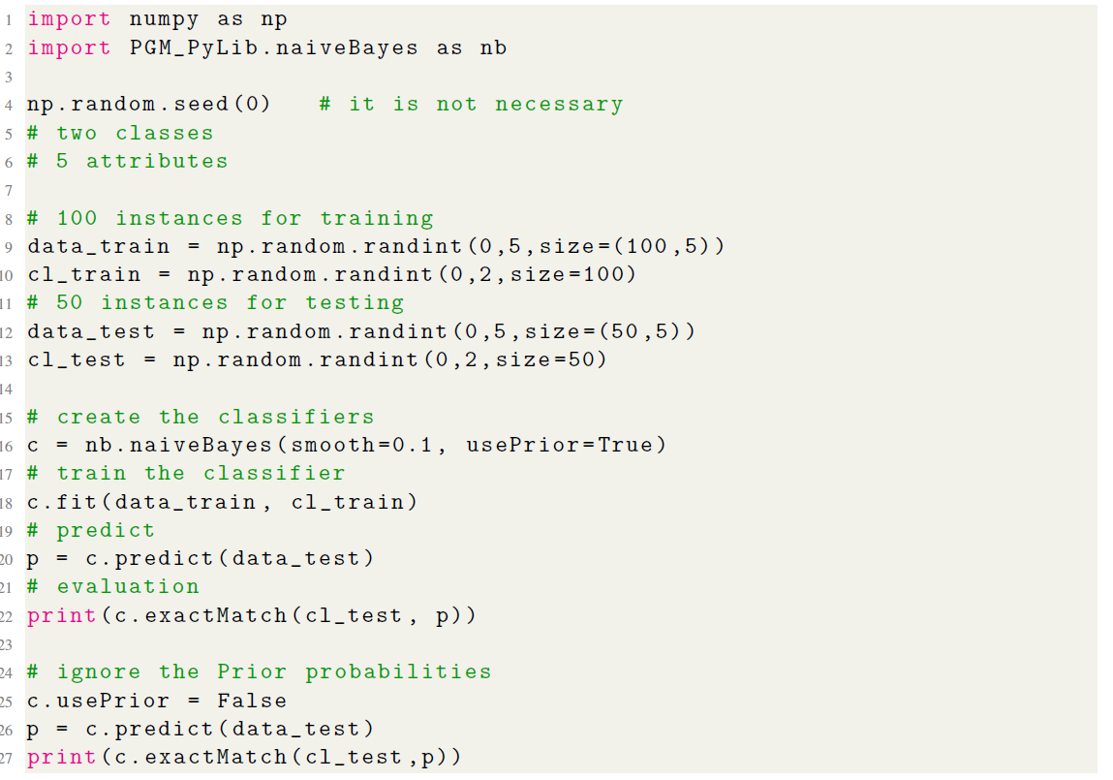
Graphical Models
Example of Naive Bayes Classifier

Slide 5
Graphical Models
Check the toolkit provided and read the manual for details.
And run the exampleNBC.py(contained in PGM_PyLib-master.zip)

Slide 6
Back Propagation algorithm
A Step by Step Backpropagation Example
Check the provided document and codes for details.

Slide 7
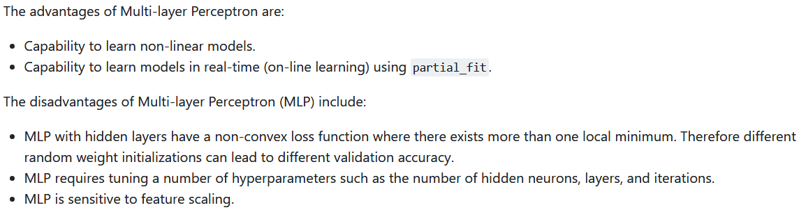
Multi-layer Perceptron (MLP)
Introduction

Slide 8
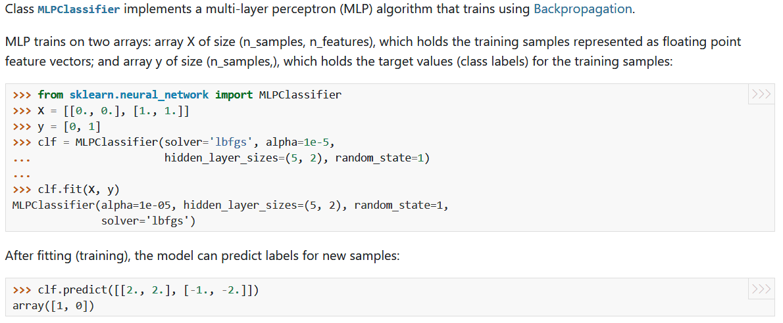
Multi-layer Perceptron (MLP)
Classification with MLP

Slide 9
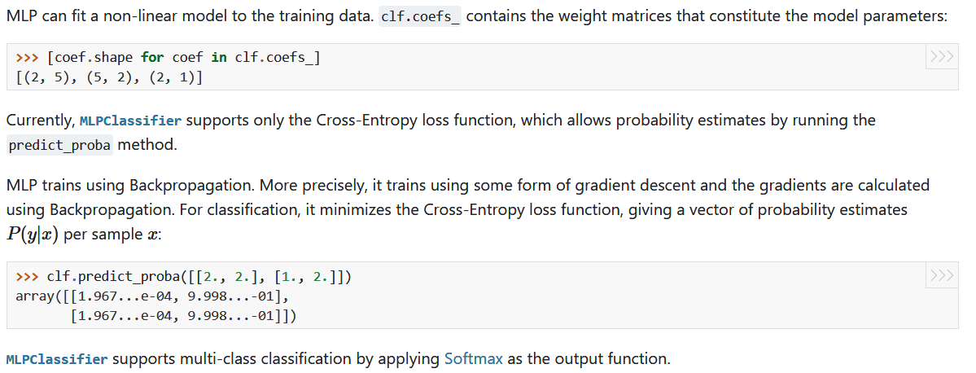
Multi-layer Perceptron (MLP)
Classification with MLP

Slide 10
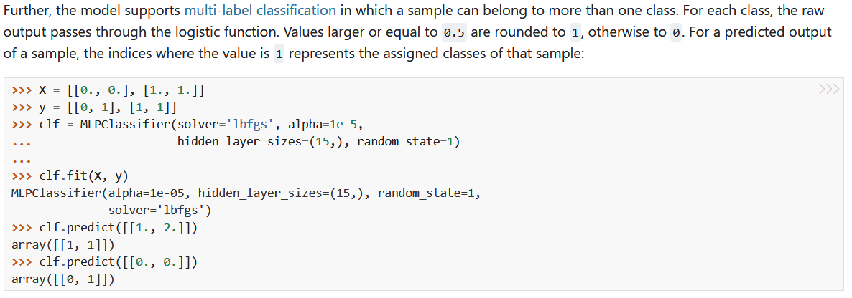
Multi-layer Perceptron (MLP)
Classification with MLP

Slide 11
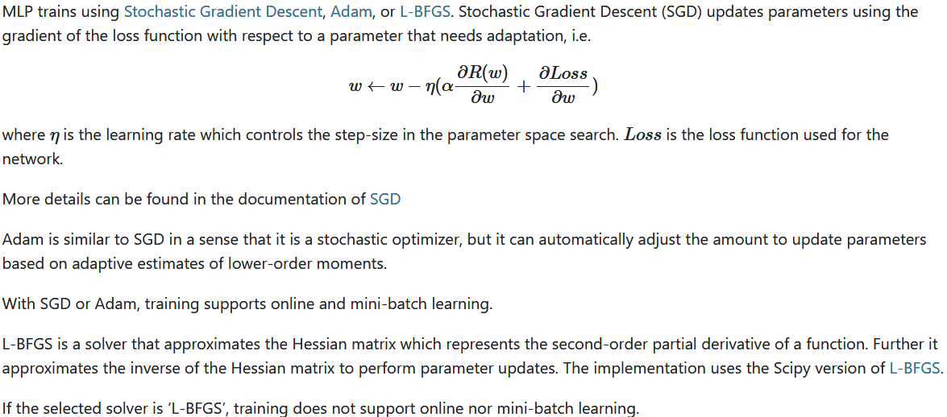
Multi-layer Perceptron (MLP)
Learning Algorithms

Slide 12
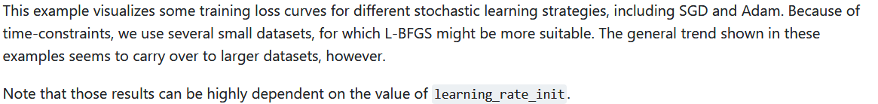
Multi-layer Perceptron (MLP)
Compare Stochastic learning strategies for MLPClassifier

Slide 13
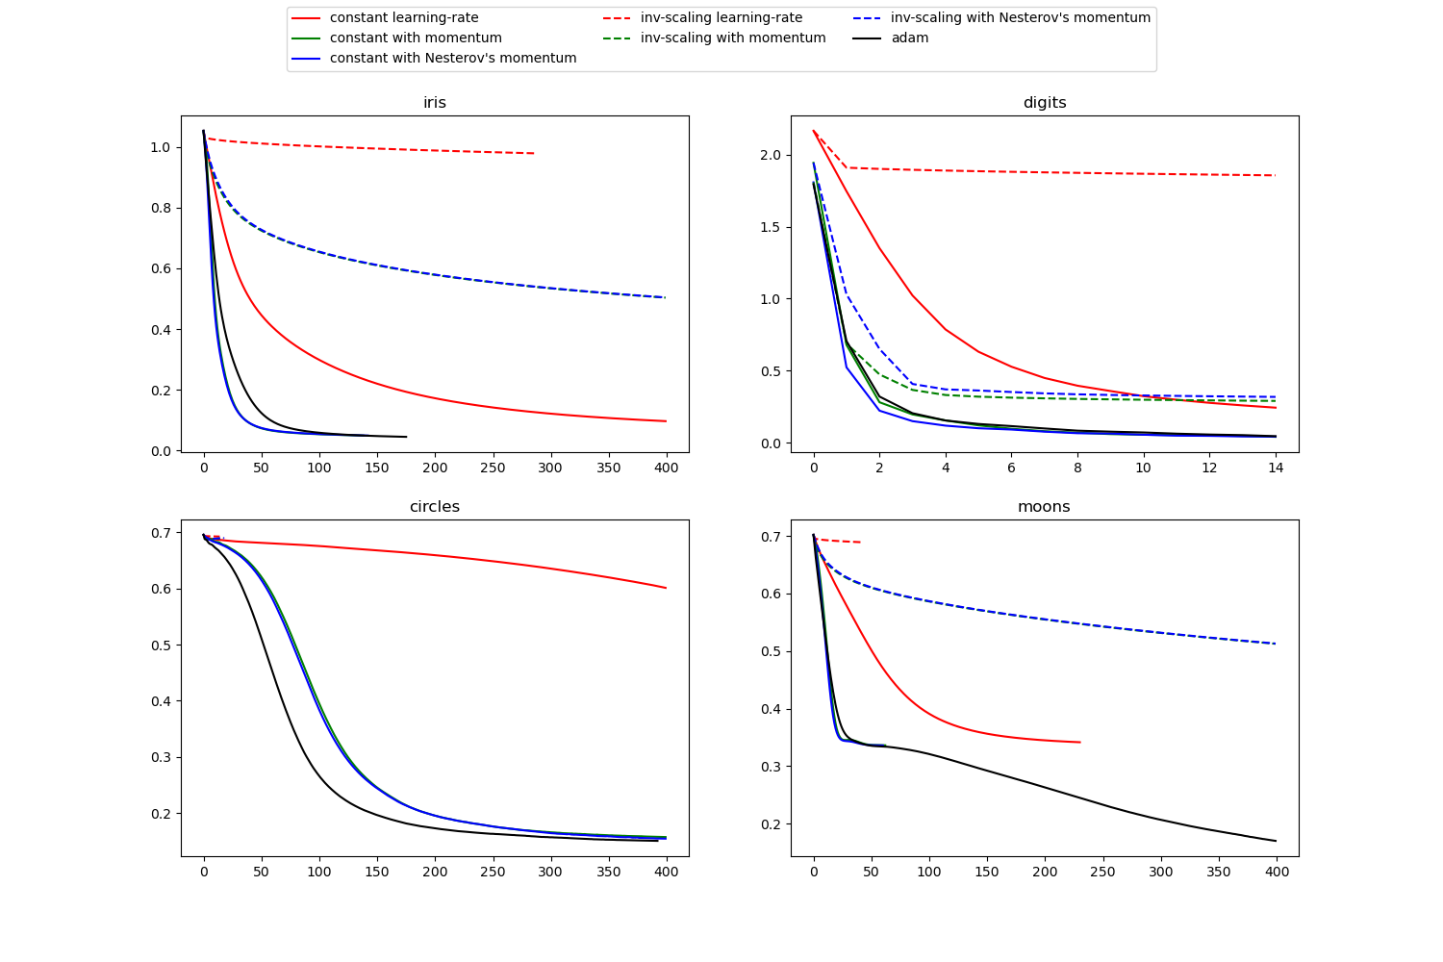
Multi-layer Perceptron (MLP)
Compare Stochastic learning strategies for MLPClassifier

Slide 14
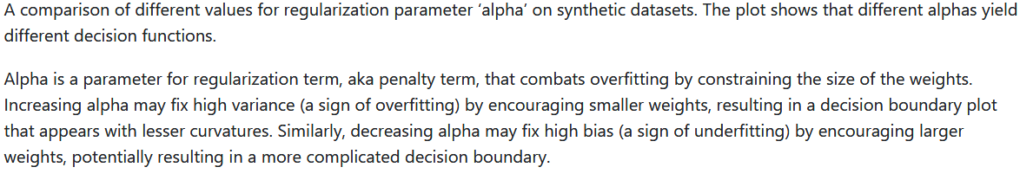
Multi-layer Perceptron (MLP)
Varying regularization in Multi-layer Perceptron

Slide 15
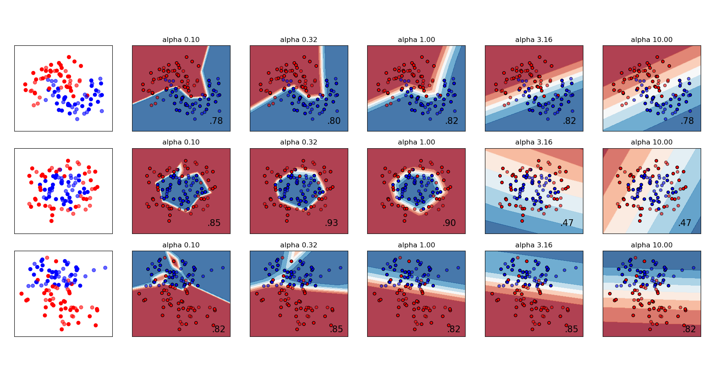
Multi-layer Perceptron (MLP)
Varying regularization in Multi-layer Perceptron

